Slide 1
Application Development using JavaFX
Name
Advisor: Dr. Li Feng

Slide 2
Outline
Project background
Technologies used in this project, with a brief introduction to each
Development process with an emphasis on JavaFX features and usage
Deployment
Future work
Bibliography

Slide 3
Project Background
What:
Desktop software for tracking a users card collection for the
Magic: The Gathering card game.
Why:
I am long time player of the game, and wanted to integrate it into a project showcasing what I have learned in my CS courses.

Slide 4
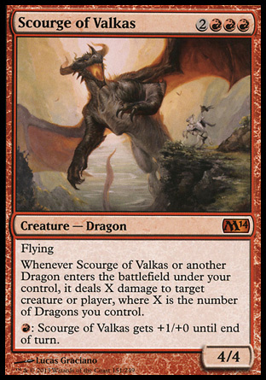
Magic: The Gathering
For those not familiar with the game, here is a (mythic) creature card.
The information on this card must be stored in a database, and a link to the image must be kept if the image is not stored locally.

Slide 5
Technologies Used
SQLite JDBC Driver - A library which allows communication with a SQLite database in Java.
JavaFX - A software platform for creating event-driven applications in Java. Originally intended to replace the popular Swing library for GUI development.
Maven – A tool for managing builds and dependencies for Java projects.

Slide 6
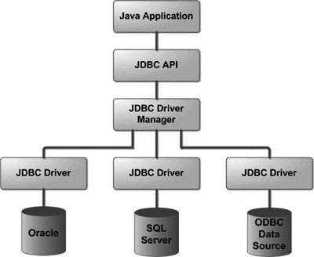
JDBC
Java Database Connectivity (JDBC) consists of several components:
API level
Driver Manager level
Individual Drivers
Database level
The Xerial SQLite-JDBC Driver used in this project works at the Driver level to allow interaction with SQLite Database engines.

Slide 7
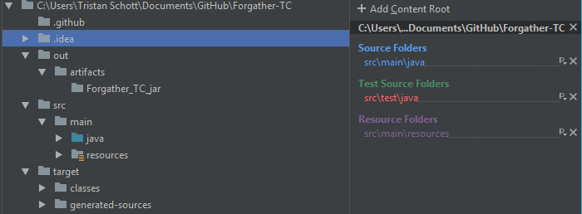
Maven
Maven is tool which automatically handles dependencies of your java project
Supported by most Java IDE’s
Simplifies the build process

Slide 8
What is Javafx?
JavaFX is a set of media packages with the purpose of making designing, testing, and deploying applications simple for Java developers.
Included by default in Java 1.8 +
Provides all UI components needed for full-featured app development
Interoperable with Swing
Media framework allows playback of multimedia content
UI components can be coded with Java or defined using FXML

Slide 9
Parts of a Project
A JavaFX project consists of at least 2 parts;
Application: A Java class extending from the JFX Application class
Controller: A Java class written to handle all logic, as well as handle all interactions with external API’s or local Databases
Controller logic can be implemented using a scripting language instead in many cases.

Slide 10
Using JFX
Start() - This function is called upon execution of your application, it will automatically create an instance of your Controller class to use. This is where you set your primary stage (main window)
Stages - Windows your application will open/close
Scenes - Components which appear on a stage
The App.java class will always contain code specifying a main (primary) stage object to display.

Slide 11
FXML (demo)
FXML is another way to specify UI layouts. An FXMLLoader is a data structure created to interpret the xml in a way the application class can understand it.
There are a few necessary tags in an FXML document:
Fx:controller – Specifies which class contains logic for this scene
Fx:id – a tag used in each individual element to assign it to a variable name
onAction – variety of these tags exist (onClick, onKey, etc)

Slide 12

Implementing logic
Making your controller communicate with your UI requires declaring variables as FXML variables. All methods which can be called from the UI must also be declared as such.

Slide 13
Deployment & Future Work
Deploy as .jar (java archive file):
Performed in IntelliJ Idea using ‘artifacts’, which are built using maven
Includes all dependencies in a single executable jar
Can distribute .jar for use on Windows, Mac, or Linux
Future Work:
Refactor Database to handle multiple card games
Implement themes using interchangeable CSS files
Resizable GUI
Parallelize UI and Controller code to reduce wait time

Slide 14
Bibliography
Tutorials Point. “JDBC Tutorial.” Www.tutorialspoint.com, Tutorials Point, 8 Jan. 2018, www.tutorialspoint.com/jdbc/index.htm.
JavaFX FAQ – Insight to the development future of JFX
http://www.oracle.com/technetwork/java/javafx/overview/faq-1446554.html#6
JavaFX Documention
https://docs.oracle.com/javafx/2/overview/jfxpub-overview.htm

